Slide 1


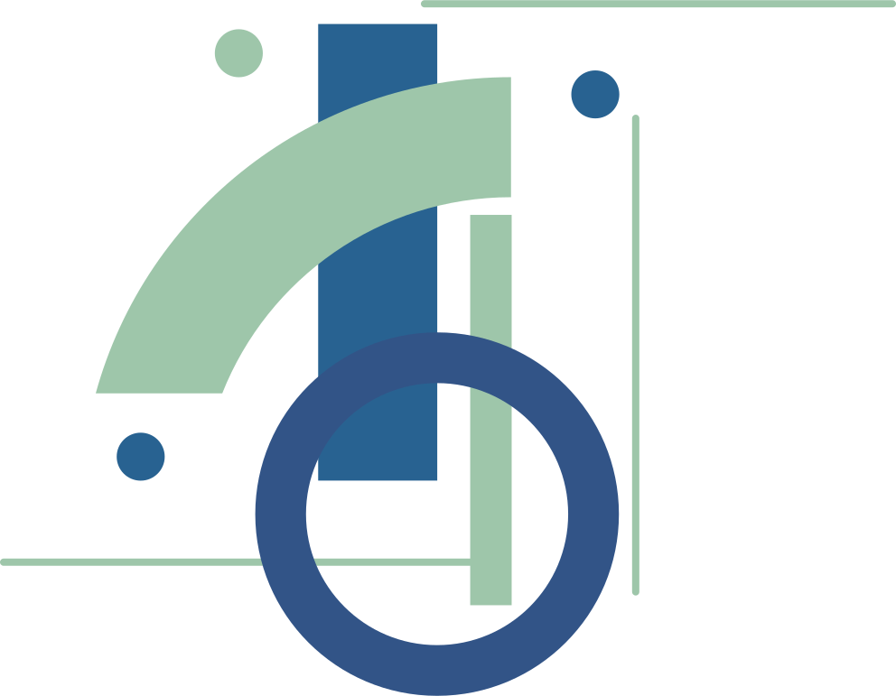








Serenity: Your Space for Digital Well-being
Project No: 2024-2-PT02-KA220-YOU-000287246
From Awareness to Action

Slide 2









The importance to Be a Good Peer Educator
Recognising Existing Strengths
Applying Learning in Practice
Empowering Future Action
Highlight the skills and experiences participants already bring to the group.
You are good at listening
You can notice when someone is not okay
You share your own experiences honestly
You include others and make them feel safe
You can stay calm in difficult situations
Explore how these strengths can be used in real situations as peer educators.
Checking in with someone who seems excluded online.
Challenging unkind or harmful posts respectfully.
Reminding friends to take breaks and rest.
Sharing tips about privacy, balance and safety.
Modelling healthy digital habits themselves
Encourage participants to translate awareness into concrete steps that promote digital well-being.
Choose one habit you will model for others.
Plan how to support a friend if they struggle online.
Create or join positive online spaces.
Speak up when something feels wrong or harmful.
Remember: peer educators don’t fix everything — they support.

Slide 3



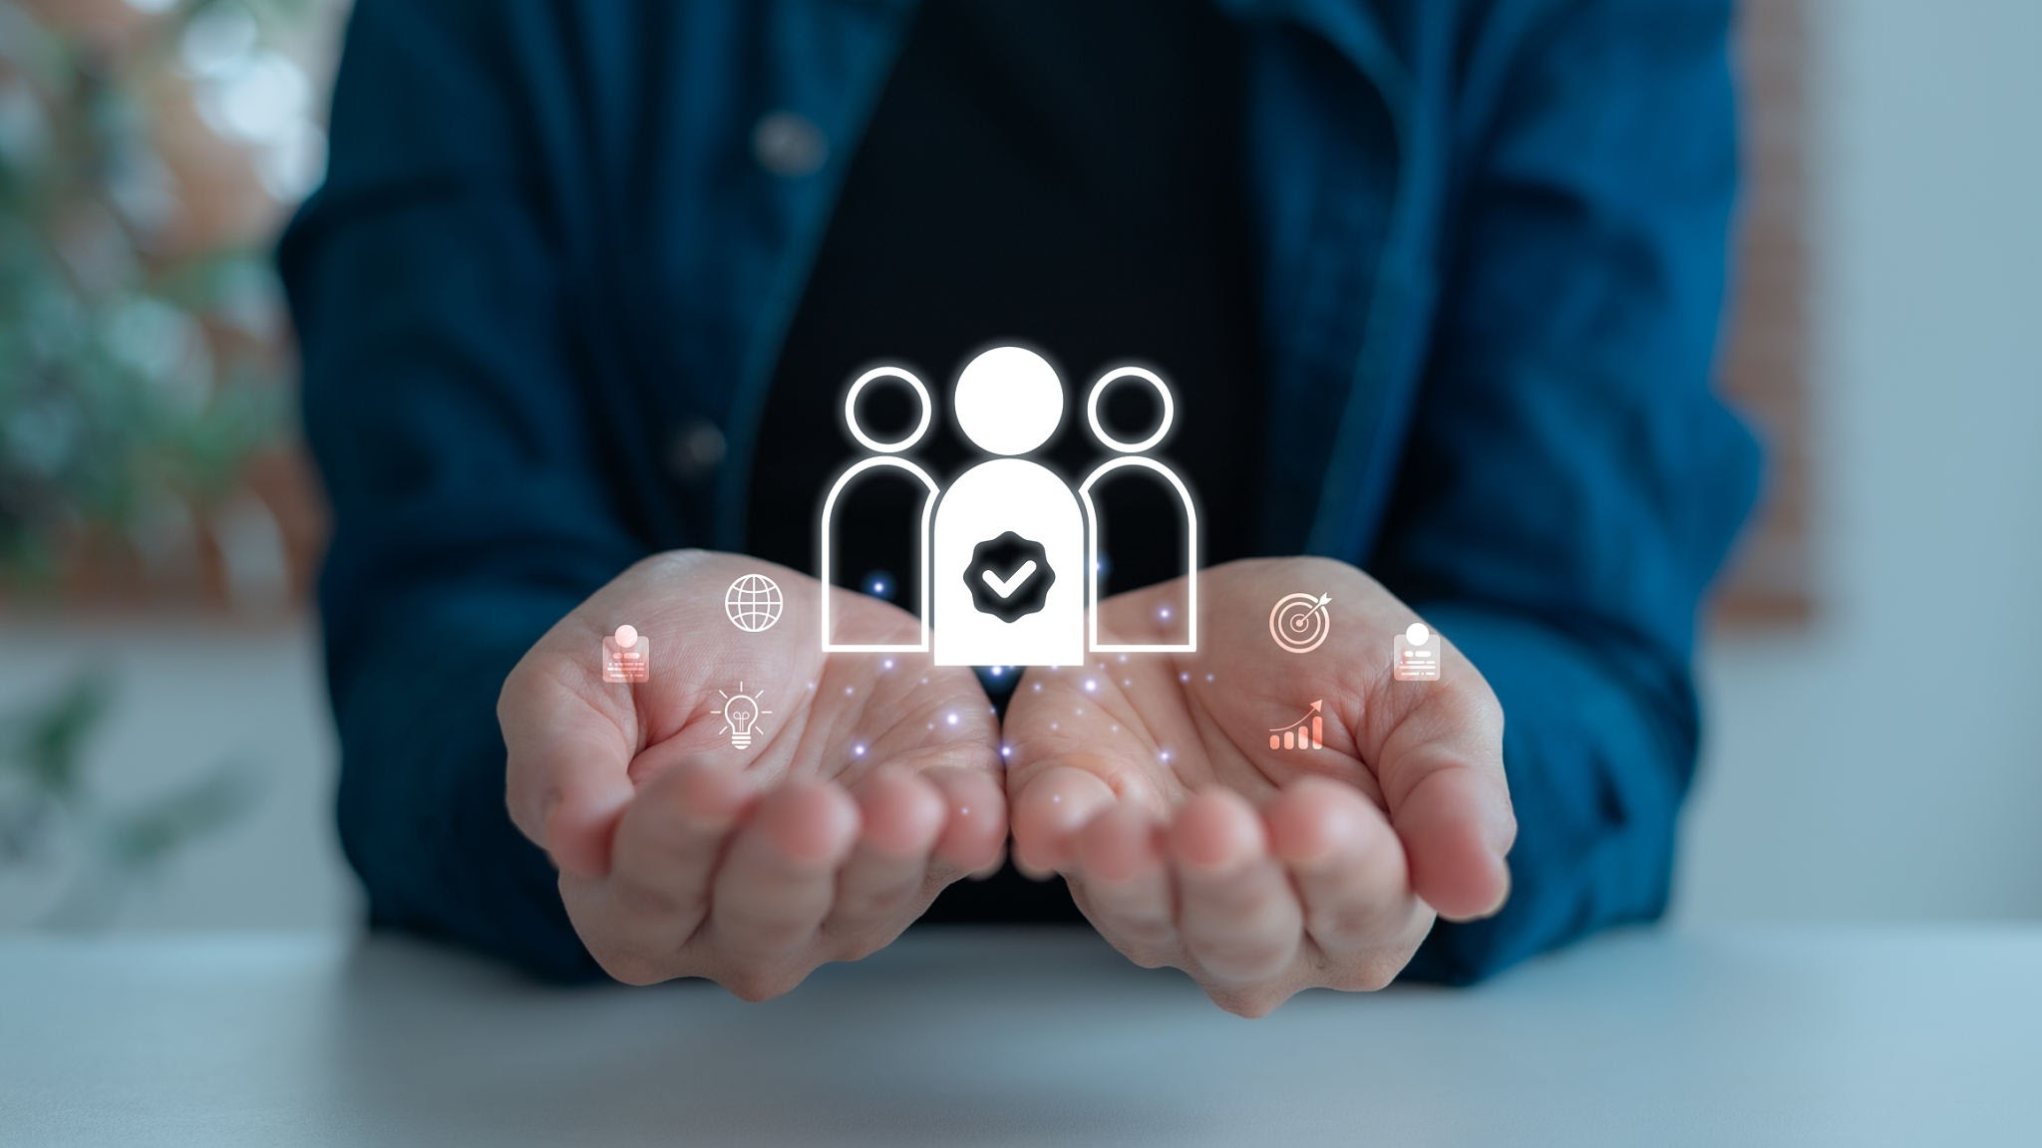


Learning Outcomes
Understand the role of a peer educator in promoting digital well-being: Help participants see what a peer educator actually does day-to-day, supporting friends, modelling healthy habits and starting safe conversations about online pressure.
Practise designing creative and realistic micro-actions for awareness and support: Give teams hands-on experience making short, achievable actions (posters, short skits,...) that raise awareness or offer peer support.
Reflect on personal experiences and recognise the value of empathy and active listening: Use campaign design to surface personal stories and practise empathetic listening, core skills for peer educators when supporting others under digital pressure.
Commit to one concrete action they can apply in their school, group, or community: Move from ideas to commitments: each participant leaves with a specific, achievable action they will try and a simple plan to follow up.

Slide 4
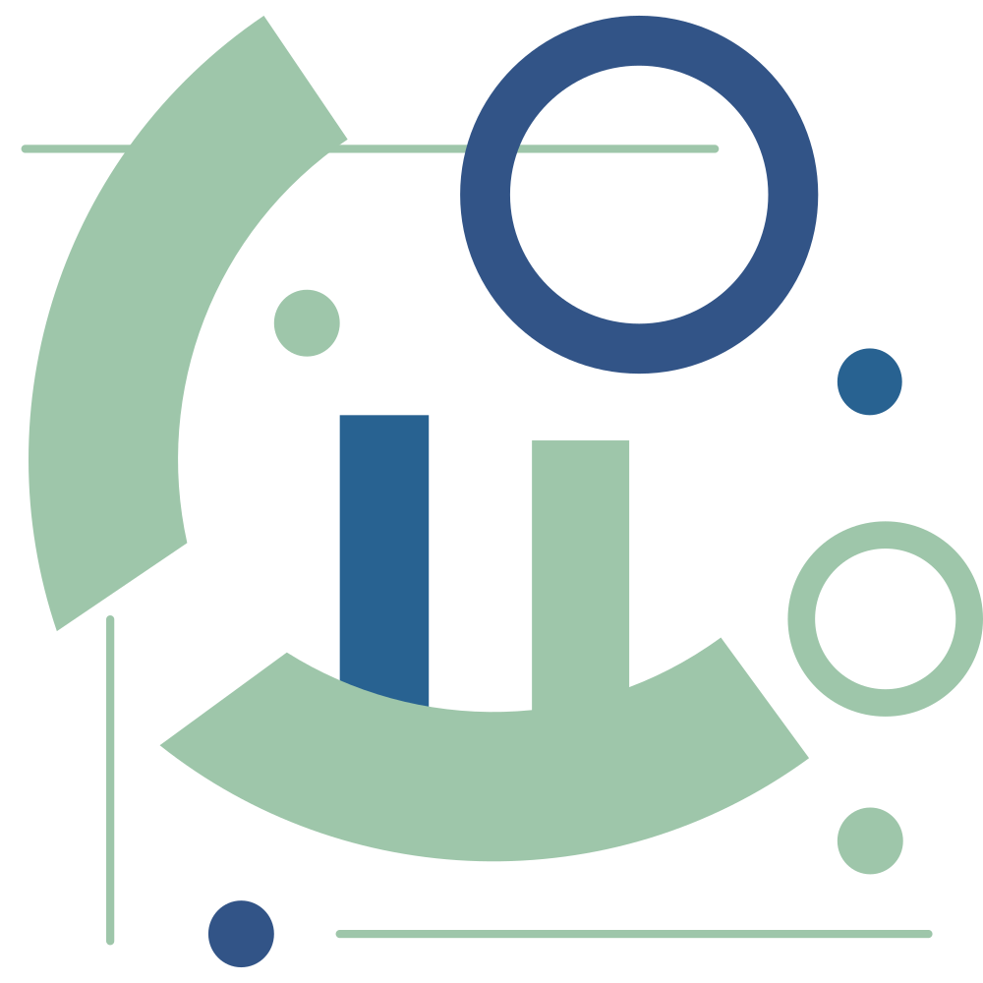




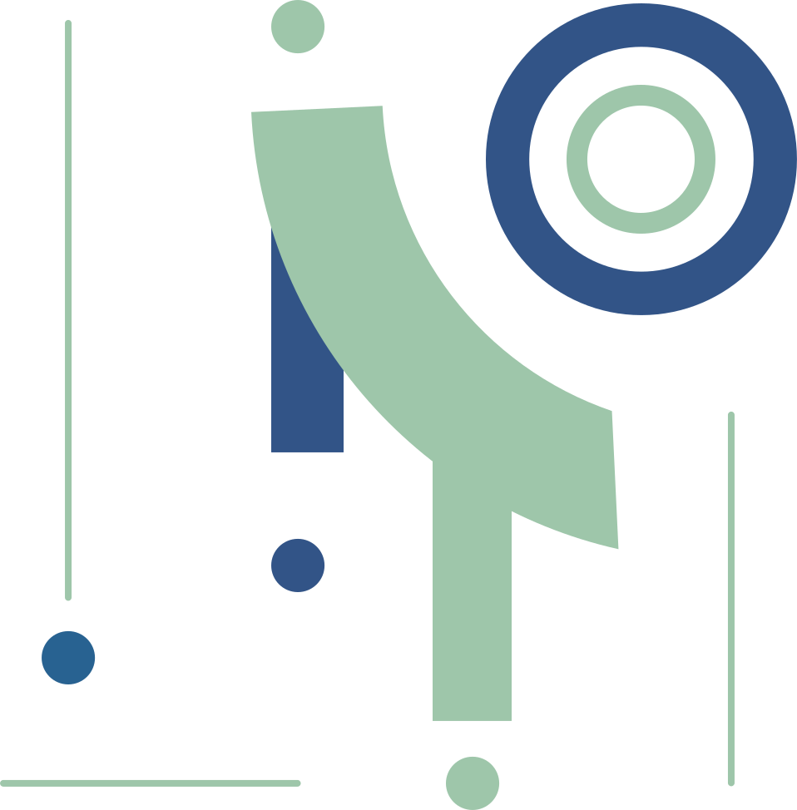
Mini Campaign Lab
Provide guiding prompts:
What is your main message?
Who is your audience (friends, classmates, community)?
What format will you use to reach them?
Split into small groups (3–4 people).
Each group designs a micro-campaign around digital well-being, choosing a format such as:
A poster with a slogan and simple tips:
- short, catchy slogan
- 2–3 easy tips or reminders
- clear images or icons
A short role-play or skit for a school setting:
- Everyday scenario (group chat,, pressure to post, rumours, FOMO)
- Problem + positive solution
- Simple message at the end
A reel or TikTok concept:
- “Before / After detox day”
- “Expectation vs Reality online”
- “3 things I do when I feel digital pressure”
A hashtag and challenge idea:
- #NoFilterMoment
- Task: post one real-life, unedited moment with a short caption about how you felt.
- Purpose: normalise real bodies, real moods, real days.
Groups present their ideas briefly
(2–3 minutes each).

Slide 5








Reflection
Peer Support Circle
When we listen with empathy, people feel:
safe
respected
not alone
This helps peer educators:
support others better
give kinder, more useful advice
build trust in the group
Sit in a circle. Each participant is invited to share (voluntarily) a short personal digital challenge (e.g. being excluded from a group chat, feeling pressure online, being overwhelmed by screen time).
After each share, the group responds with supportive statements like:
“If I were your peer educator, I would…”
“One way I could support you is…”
Facilitator ensures safety, confidentiality, and no judgement.
Group debrief notes
Small and realistic actions are easier to start and sustain, they build confidence through quick successes and lead to real change, while broad or abstract goals often remain only intentions.
Each participant receives an “Action Commitment Card”.
Prompt: “Write down one small action you will take as a peer educator to promote digital well-being in your group, school, or community.”
They place their cards on a wall (collective commitment board).
Closing round: each participant shares one word about how they feel leaving the session (e.g. “ready”, “motivated”, “empowered”).

Slide 6
How Actions can be Applied in Real Life
In schools:
Check in with classmates who seem left out online
Model healthy digital habits (breaks, kindness, balance)
Create small awareness actions: posters, short skits, tutor-group discussions
Speak up calmly when posts or comments become harmful
In youth groups:
Use peer support circles to share online challenges safely
Organise mini-campaigns about digital pressure and well-being
Encourage realistic “micro-actions” instead of big promises
In the community:
Share privacy and safety tips with friends or siblings
Join or create positive online spaces
Promote “no-filter”, real-life content and supportive messages

Slide 7

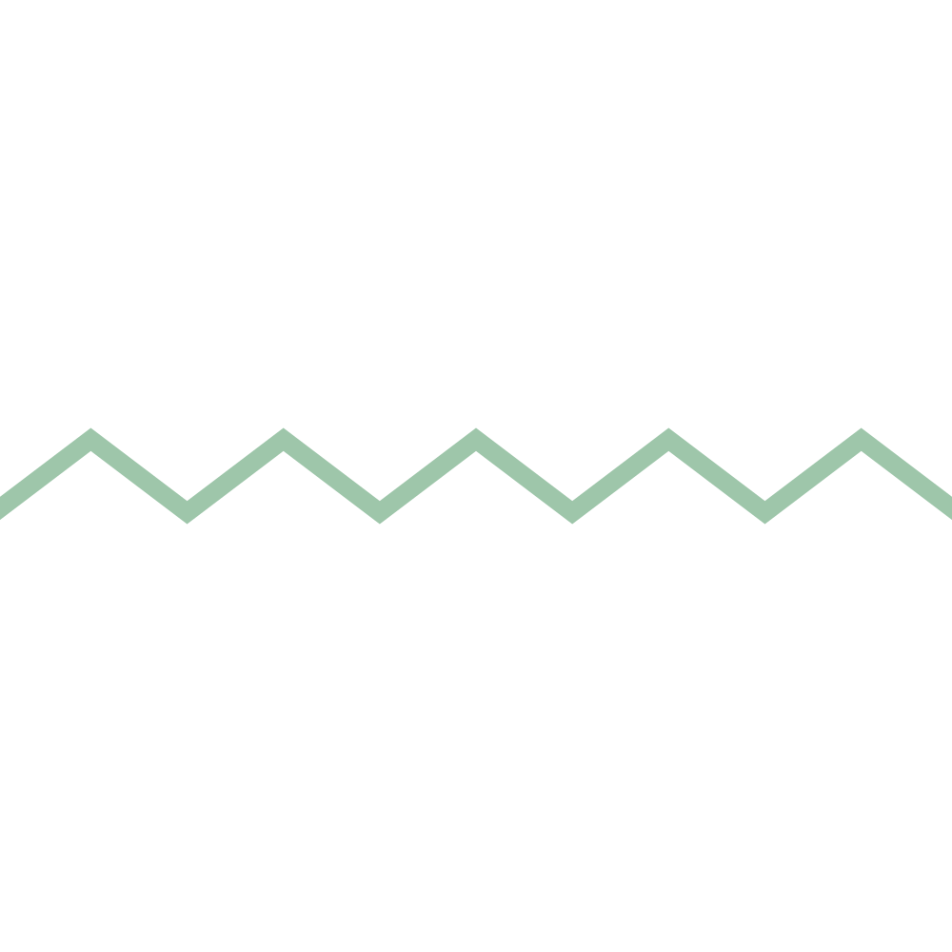


THANK YOU
Serenity: Your Space for Digital Well-being
Project No: 2024-2-PT02-KA220-YOU-000287246
From Awareness to Action
Website: www.serenityproject.eu
Funded by the Erasmus+ Programme, Serenity empowers young people to take control of their digital habits and support each other through peer learning leading to positive change.
Project Number: 2024-2-PT02-KA220-YOU-000287246

