Slide 1


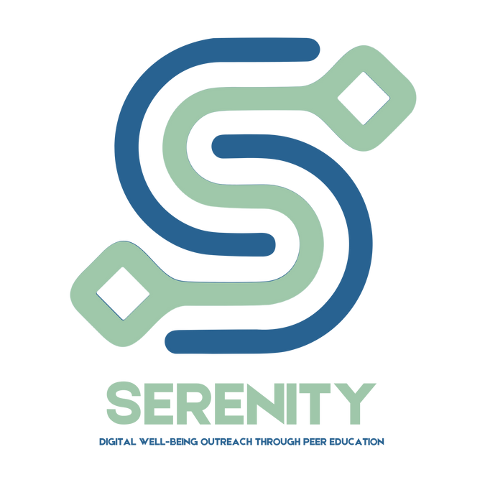






Serenity: Your Space for Digital Well-being
Project No: 2024-2-PT02-KA220-YOU-000287246
Day 2: Being a Peer Educator
Session 3: Facilitation Lab

Slide 2






Session Goal & Learning Outcomes
Today’s goal is to practice facilitation skills - in groups you will get an opportunity to review resources and deliver micro-sessions.
After today’s session, you will be able to:
Review and adapt existing resources
Give and receive constructive feedback to improve facilitation skills
Explore group dynamics and how to create safe learning spaces

Slide 3
Our experiences
Think of any memorable experiences where you have received really good training or advice and review the aspects that made it memorable.
What is the key to engaging peer facilitation?

Slide 4


Groupwork – Facilitation Lab
Divide into groups of 3-4 people, ensure a mix of backgrounds to enrich discussion.
Each group selects one or more elements from the existing Serenity Digital Well-being Toolbox of Interactive Infographics & Online Modules resources, such as:
Design a 5-minute micro-session.
a tip sheet,
activity,
video,
escape room

Slide 5
Groupwork – Facilitation Lab
Keep in mind that their micro-session should aim to:
o demonstrate or teach a concept related to digital habits,
o engage the rest of the group in a short activity or discussion,
o be clear, interactive, and practical.
Use roleplay, visuals, or storytelling as well as inclusivity to make sure everyone is engaged.
Deliver your micro-sessions to the rest of the participants.
After each micro-session, peers provide constructive feedback:
o What worked well?
o What could be improved?
o How effectively was the Toolbox content used?

Slide 6
Groupwork – Facilitation Lab
    A good peer facilitator:
Creates a safe and inclusive space
Keeps everyone involved
Manages time and group energy
Encourages listening and respect
Makes it easy for others to take part
    Good peer educators adjust their sessions depending on:
Age (simpler language for younger groups)
Group size (more discussion in small groups, more structure in larger ones)
Context (school, youth club, online, informal space)
The goal is always the same:
Make it clear, safe, and relevant for the people in front of you.

Slide 7
Let’s share our experiences!
Group discussion on what worked well and what to improve regarding reviewing and using the existing resources in the Serenity Toolbox.
What new aspects did you gain about designing the micro-sessions?
Which micro-session format felt most engaging or effective, and why?
How did your group collaborate during the design process, and what were the strengths and challenges?
In what ways did the Serenity Toolbox resources improve your micro-session, and how could they be used differently next time?
What would you do differently if you were to design another micro-session on digital well-being?

Slide 8
Reflection Time
Reflect on how these resources might support your friends and peers, and consider effective ways to share and promote any valuable tools or information you discover.
Which concept/tip or idea from the micro-sessions could I realistically apply in my daily routine?
Who in my life could benefit from what I’ve learned, and how might I share it with them?
How could I become a better peer educator in light of designing and delivering today's micro-session to my peers?

Slide 9

THANK YOU
Serenity: Your Space for Digital Well-being
Project No: 2024-2-PT02-KA220-YOU-000287246
“Being a Peer Educator”
Facilitation Lab
Website: www.serenityproject.eu
Funded by the Erasmus+ Programme, Serenity empowers young people to take control of their digital habits and support each other through peer learning leading to positive change.
Project Number: 2024-2-PT02-KA220-YOU-000287246

