Slide 1







Serenity: Your Space for Digital Well-being
Project No: 2024-2-PT02-KA220-YOU-000287246
Day 3: Leading with Impact
Session 1: Peer Educator Pitch

Slide 2



Session Overview
“Our goal today is simple: to create and present an idea that promotes digital well-being.”
“The focus is on three things: creativity, communication, and leadership.
That means using your imagination, expressing your ideas clearly, and working as a team to bring your vision to life.”
“And the outcome? You’ll leave this session feeling more confident, ready to advocate for change, and to inspire your peers to think differently about how we live and connect online.”

Slide 3
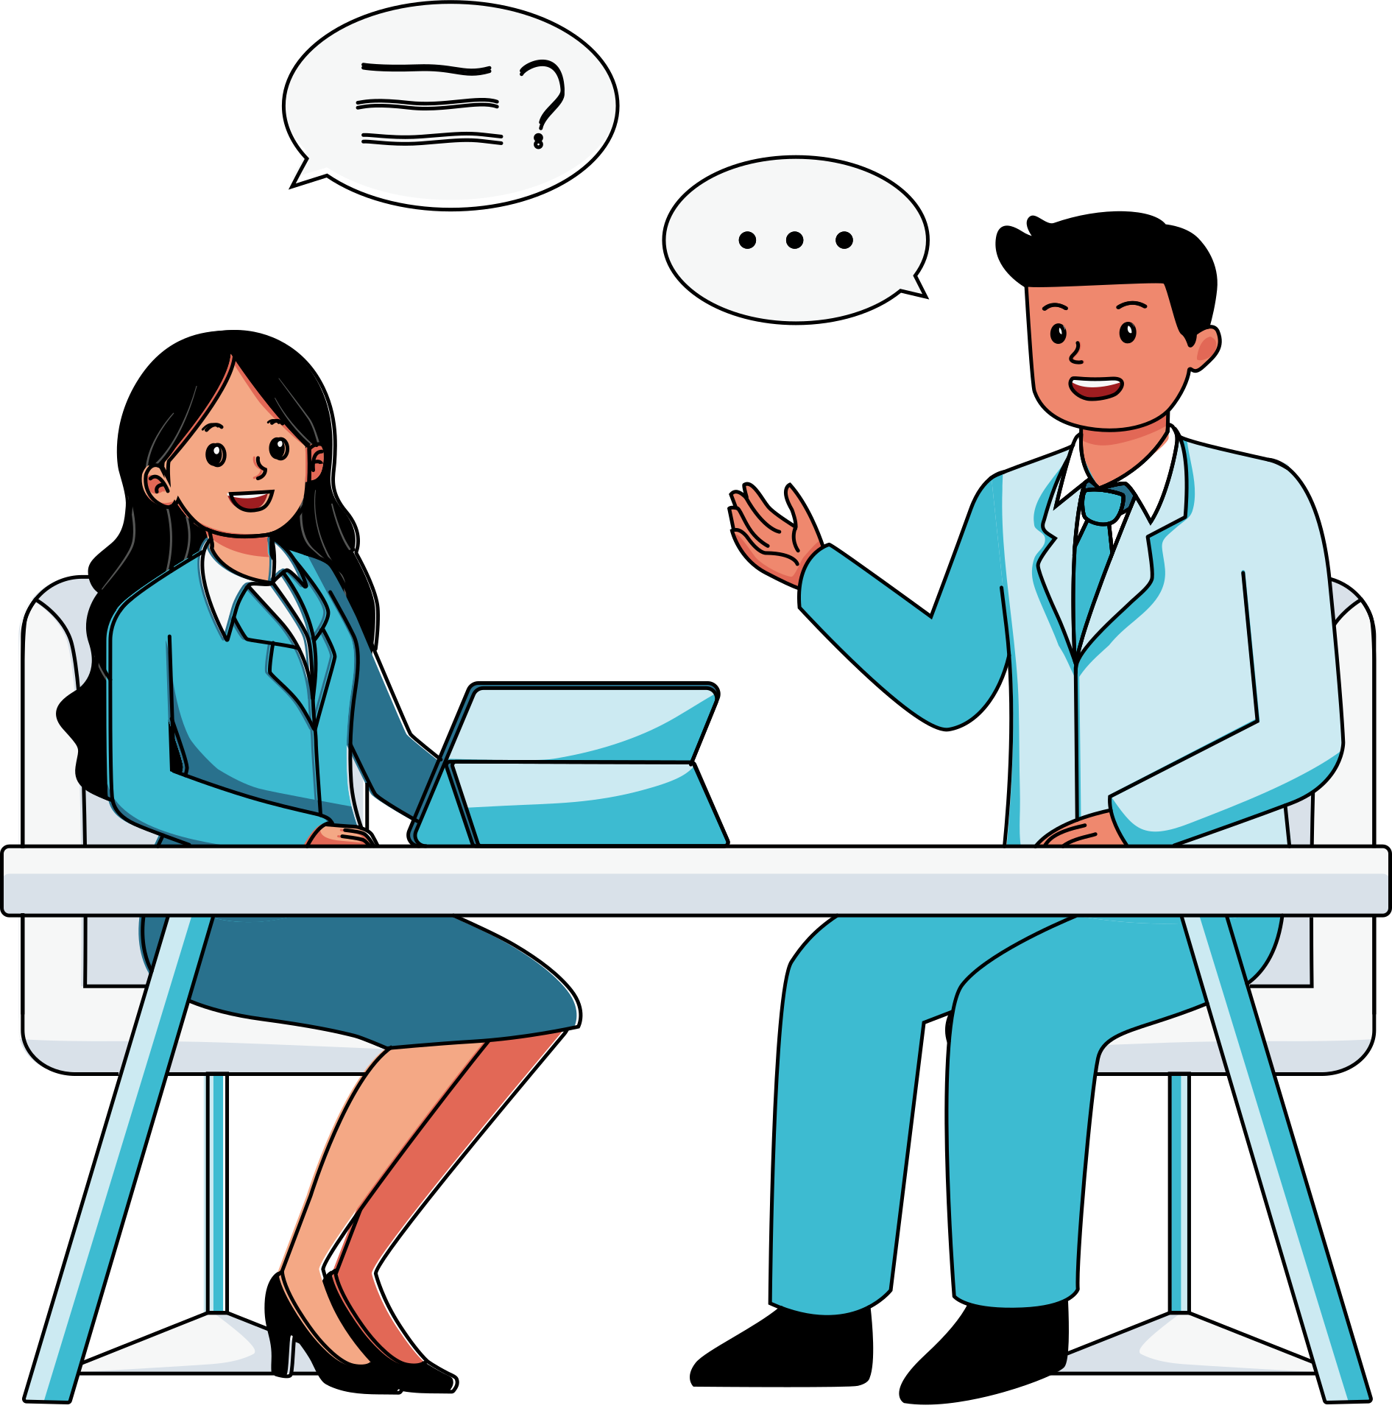


What Is a Peer Educator Pitch?
It’s a short, creative presentation, just two minutes long where you share a project or campaign idea that can make a positive difference in your community.
“You’re not just talking about an idea, you’re pitching it, selling it, bringing it to life!”
“Think of yourselves as young leaders, changemakers, and advocates for digital well-being.”
“Every great change begins with one confident voice.”

Slide 4


Why It Matters
build your confidence in speaking,
This session helps you:
strengthen teamwork
learn how to inspire your peers
“Your voice matters. Your story can lead others.”

Slide 5

Learning Outcomes
By the end of this activity, you will be able to:
  apply leadership and communication skills to promote digital well-being,
  design and present a campaign idea,
  collaborate with your group, and
  reflect on how your message can inspire action.

Slide 6


What does a great Peer Educator Pitch need?
Confidence
Clarity
Creativity
Grow Your Pitch Tree
Energy
Teamwork
Empathy
Structure
Positivity
Call to Action

Slide 7
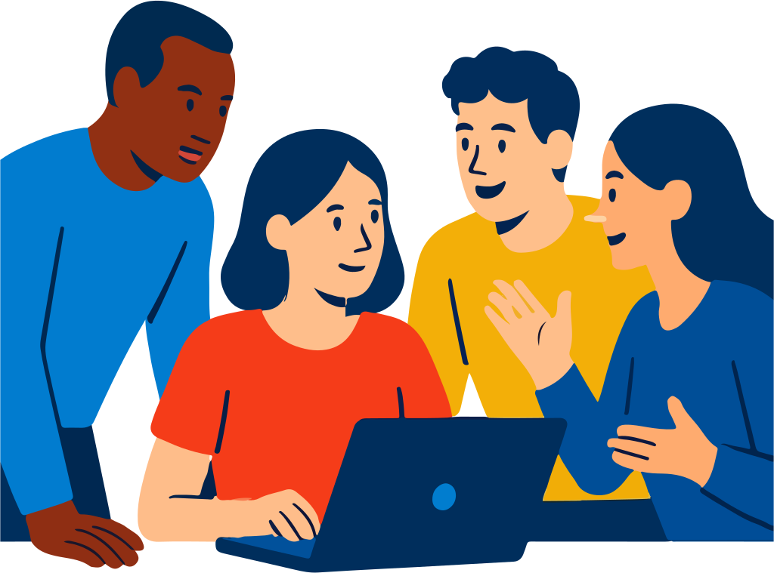
Team Up
Form groups of three to four people.
Introduce yourselves, talk about your everyday digital experiences, the good and the challenging.”
Let’s begin!
  What online issue do you think needs more awareness?
  Is it kindness?
  Is it screen time balance? Privacy?
Choose the one that speaks to you.
Once you’ve decided, come up with a creative campaign name something short and catchy.
You have 10 minutes to brainstorm.

Slide 8


Design Your Campaign
Now that you have your theme, let’s design your campaign.
Think about four key things:
  What is your message?
  Who is your audience?
  What action do you want people to take?
  And what kind of impact do you hope to make?”
You have 20 minutes to plan your campaign. Be creative!

Slide 9
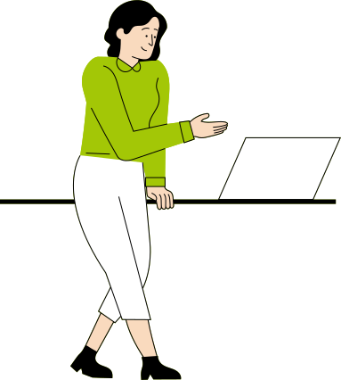
Create Your Pitch
1
Now it’s time to prepare your 2-minute pitch.
You can use a short skit, a poster, a slideshow, or even a slogan whatever brings your message to life.
Remember: keep it simple, engaging, and clear.
Your group has 20 minutes to get ready. Practice your pitch and make sure every voice in the group is heard.
2
3
4

Slide 10
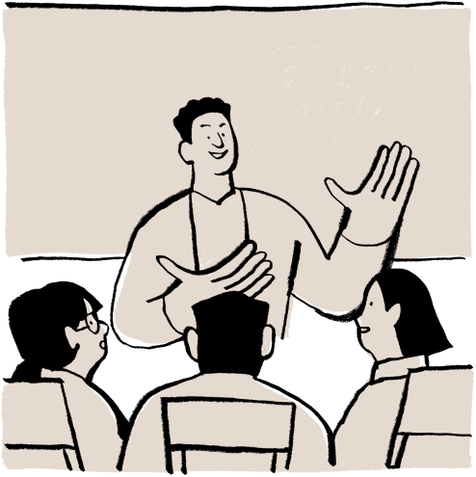
Pitch Time!
Each group will now have two minutes to present their pitch.
When you listen to others, focus on giving positive feedback:
  What inspired you about their idea?
  What could make it even stronger?”
Let’s celebrate every idea with applause and encouragement, this is a space for creativity and confidence.

Slide 11

Reflection & Debrief
What did you learn about communication and teamwork today?
What makes a message memorable?
How did it feel to share your idea with others?
Remember: leadership starts when ideas turn into action.

Slide 12

Let’s Take Action
Now think about how you can take your campaign beyond this room.
1. What would it look like if you actually ran this event at your school, or youth center?
2. Who could you partner with to make it happen?
Even one small step sharing a post, starting a conversation can lead to impact.
The best leaders don’t just talk about change, they make it happen.

Slide 13

Reflection Time
Before we close, take a minute to reflect personally.
Write down:
  Two strengths you demonstrated today.
  One communication skill you’d like to improve.
  And one realistic action you could take to share your digital well-being message.
Confidence grows every time we dare to speak up.

Slide 14
THANK YOU
Serenity: Your Space for Digital Well-being
Project No: 2024-2-PT02-KA220-YOU-000287246
‘’Leading with Impact’’
Peer Educator Pitch
Website: www.serenityproject.eu
Funded by the Erasmus+ Programme, Serenity empowers young people to take control of their digital habits and support each other through peer learning leading to positive change.
Project Number: 2024-2-PT02-KA220-YOU-000287246

